Slide 1

Bank Management System
Presenter : Rohan Balami

Slide 2

OVERVIEW
To revolutionize the traditional manual methods used in banks by implementing an efficient and secure software solution.
By digitizing data storage and eliminating the reliance on handwritten documents.
It aims to optimize operations, enhance customer satisfaction, and improve data security.

Slide 3
PROBLEM STATEMENT
Heavily on manual paperwork.
The lack of effective data backup mechanisms.
Fraud.
Time consuming.

Slide 4
PURPOSE
To make program.
To clear concepts of C programming.
To learn use of C programming to solve real life problem.
To show the knowledge of C Language.

Slide 5
OBJECTIVE
Enhance Organizational Management
Paper Usage
Optimize Time and Manpower Utilization

Slide 6
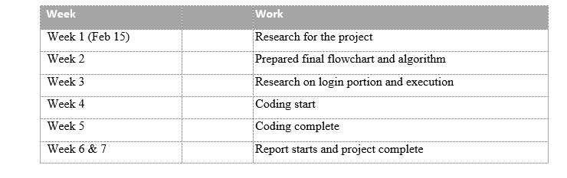
PROJECT PLANNING

Slide 7
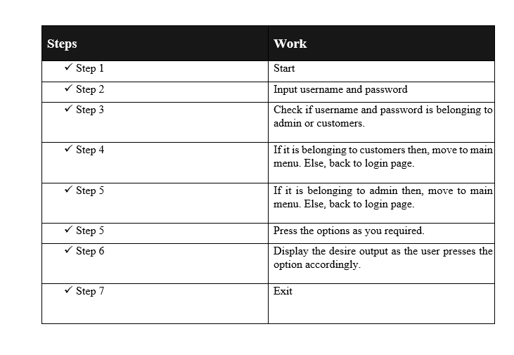
ALGORITHM

Slide 8
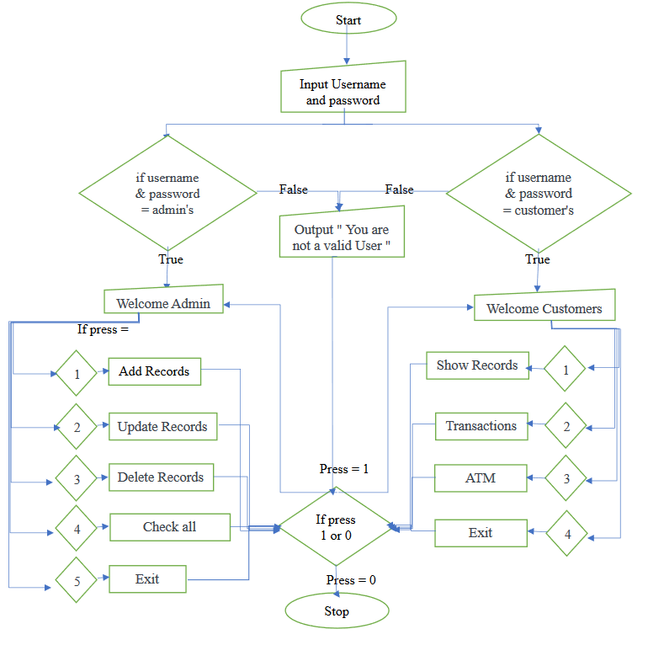
FLOW CHART

Slide 9
APPLICATION

Slide 10
Thank You

